Slide 1
E- Vacuation
A online evacuation Information System

Slide 2
Why E-vacuation ?
I work on this concept in school.
We only develop a mobile app, and I want to try it out on the web.
Data being pushed around and updated
Tables

Slide 3
Framework/Libraries Used
01
02
03
04
Apache Struts 2
Bootstrap 5
HTML & CSS
MySQL Workbench

Slide 4
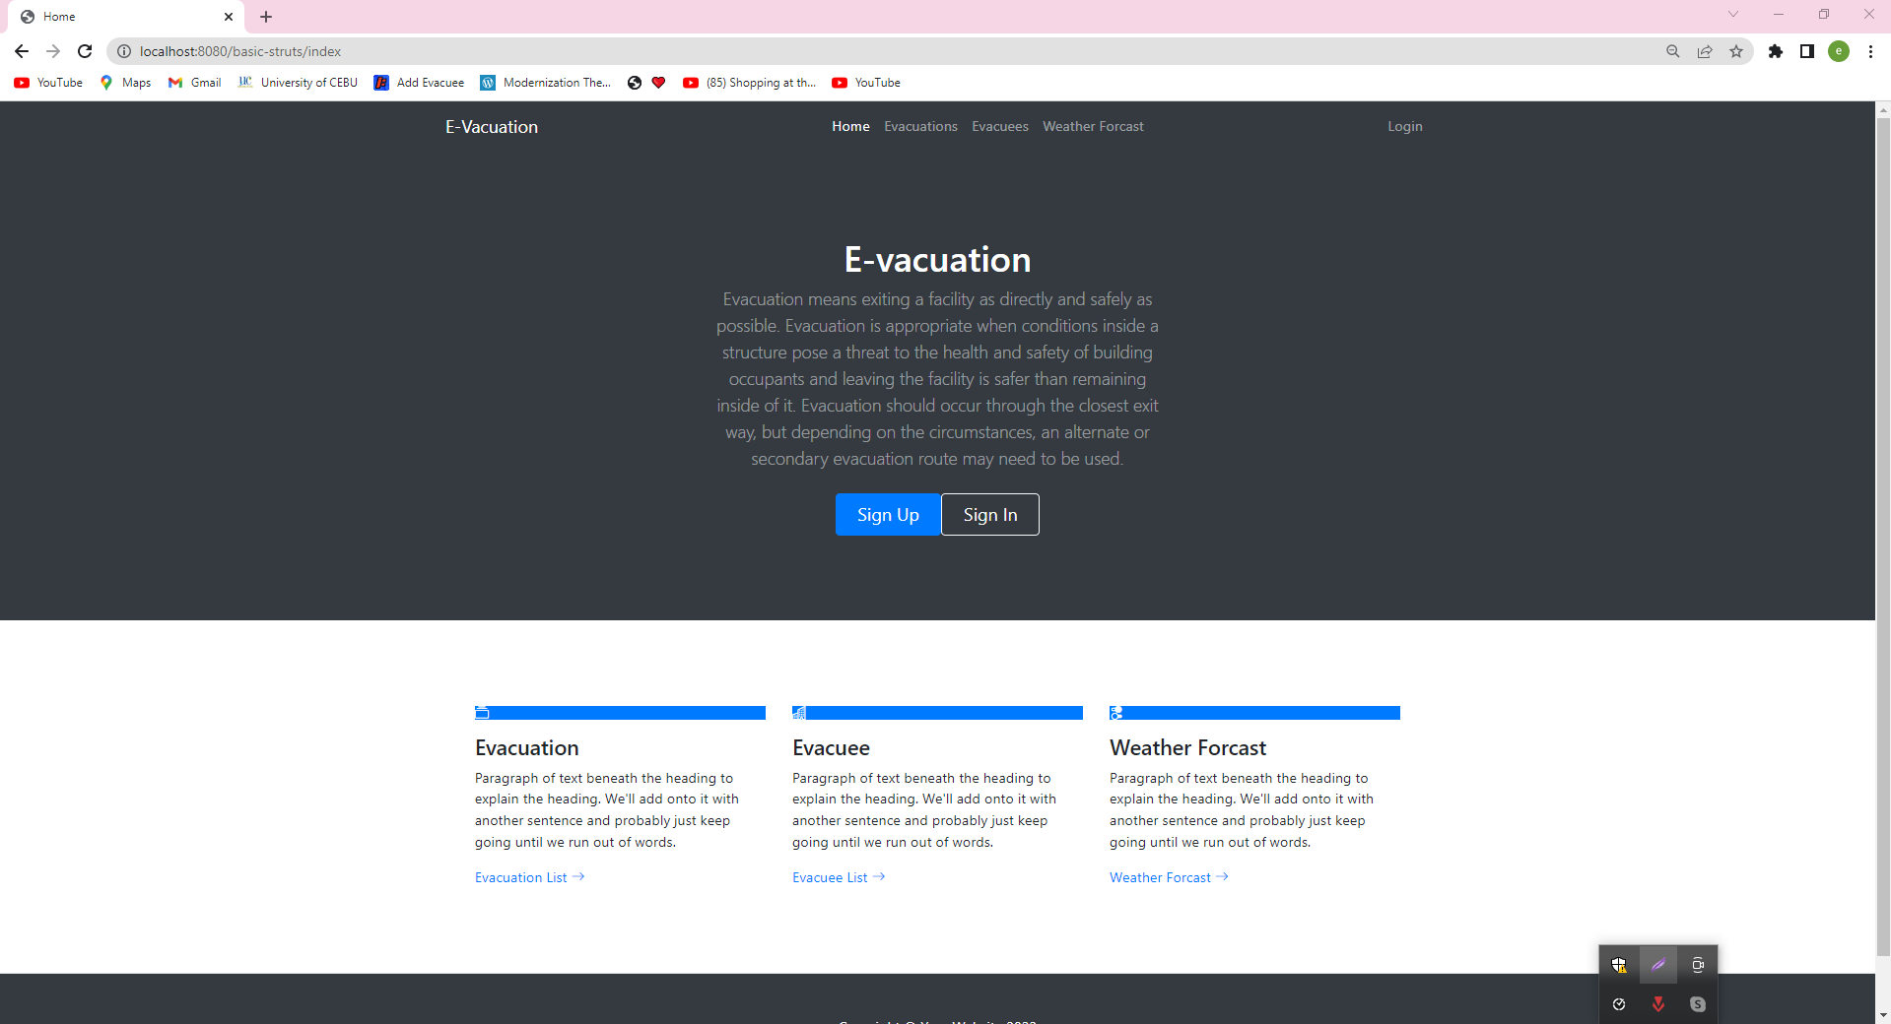
Site Pages
Landing Page

Slide 5
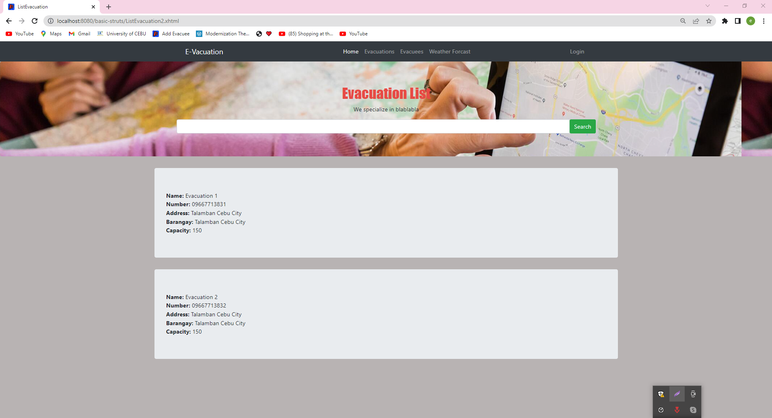
Site Pages
User Evacuation Page List

Slide 6
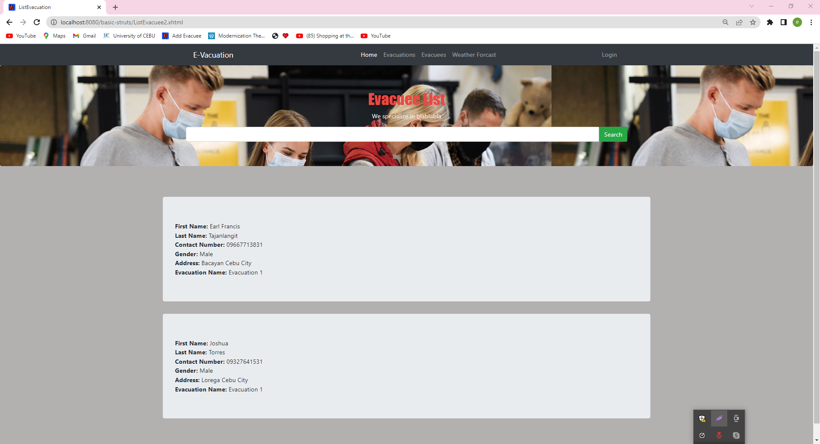
Site Pages
User Evacuee Page List

Slide 7
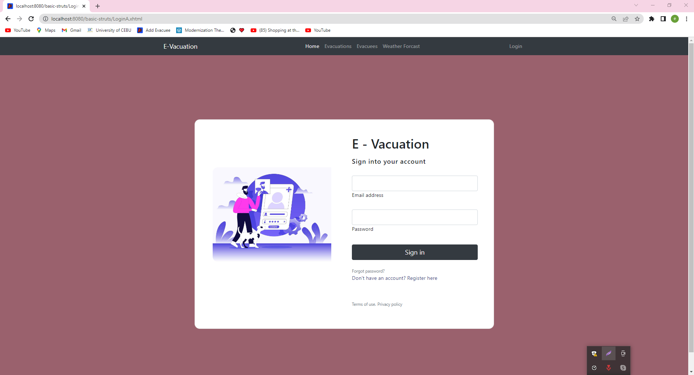
Site Pages
Admin - Login Form

Slide 8
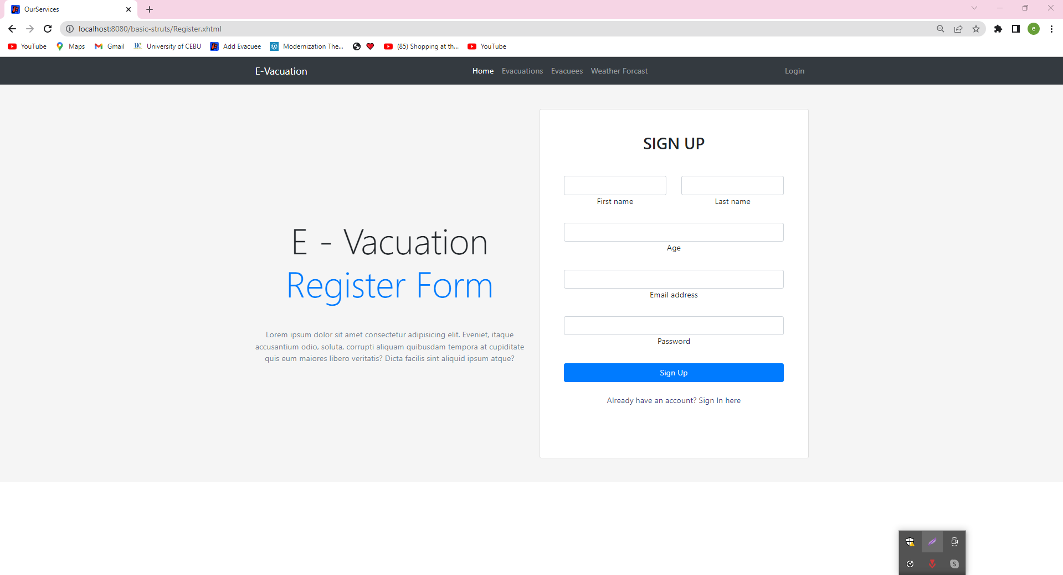
Site Pages
Admin - Registration Form

Slide 9
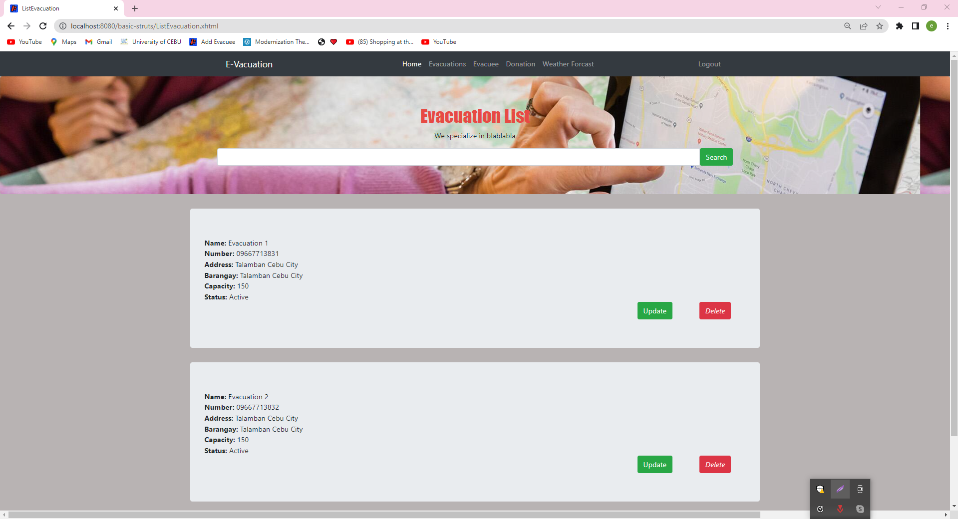
Site Pages
Admin - Evacuation List

Slide 10
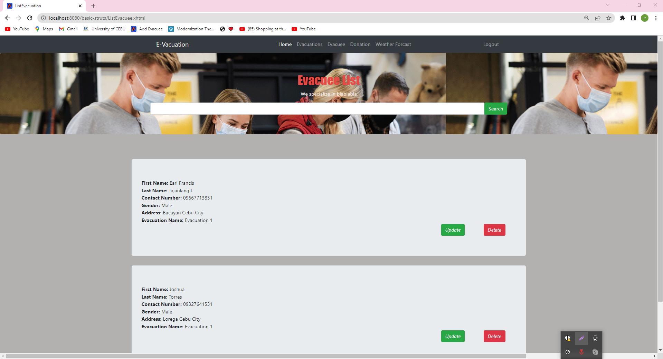
Site Pages
Admin - Evacuee List

Slide 11
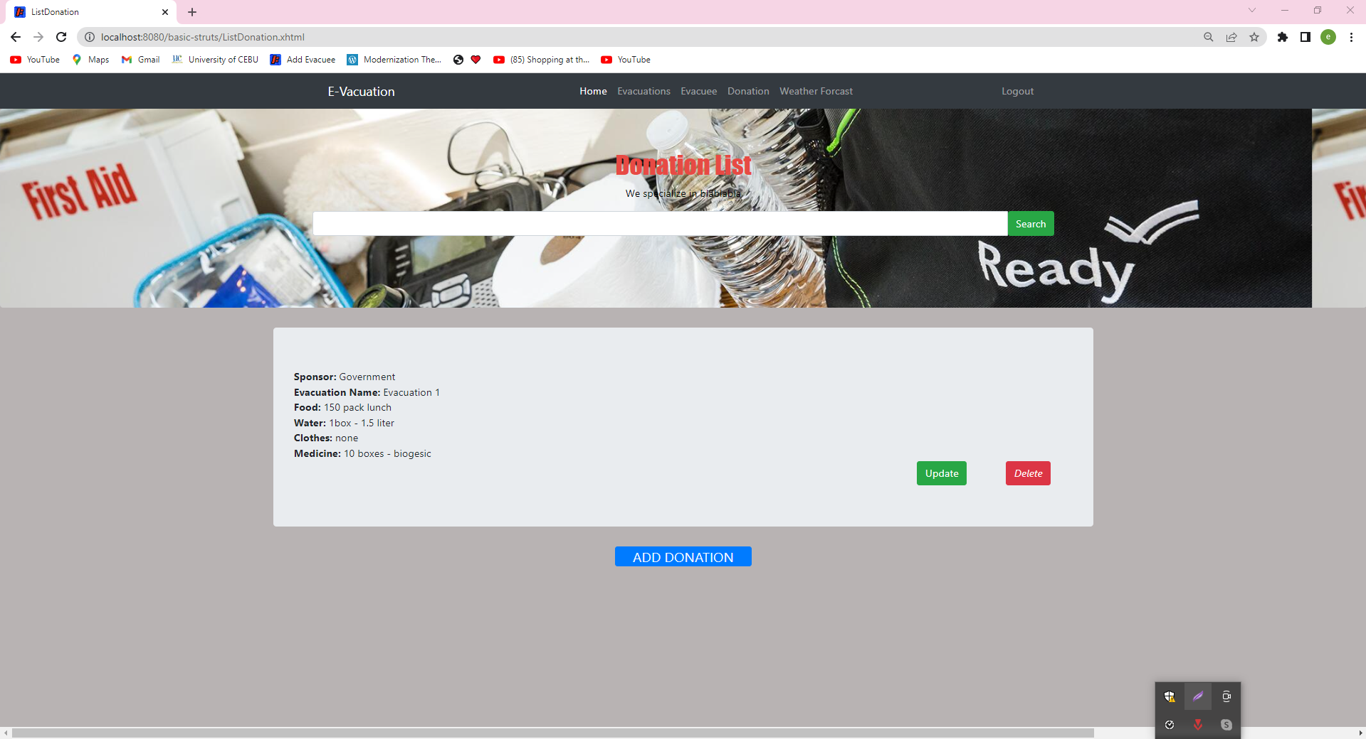
Site Pages
Admin - DonationsList

Slide 12
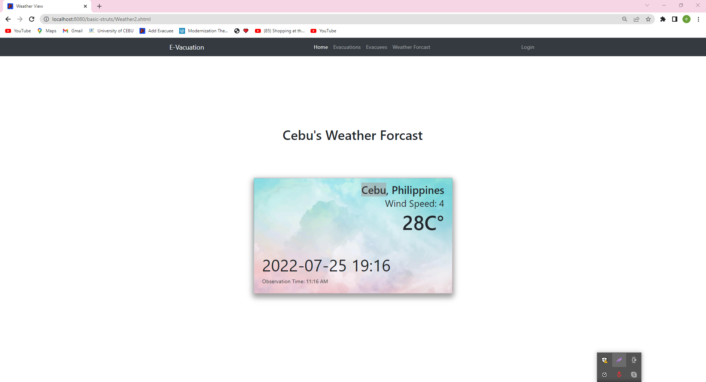
Site Pages
Admin - Weather Forcast

Slide 13
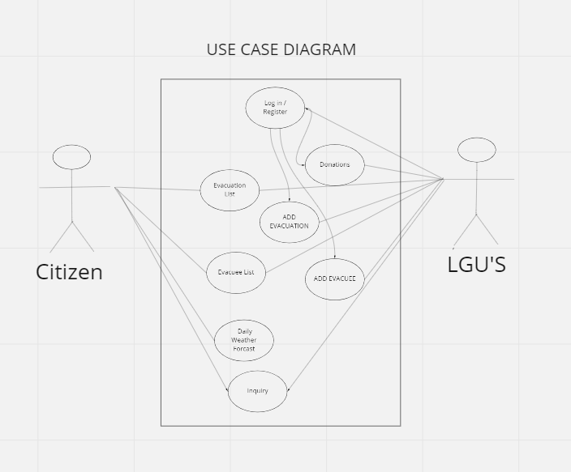

Slide 14
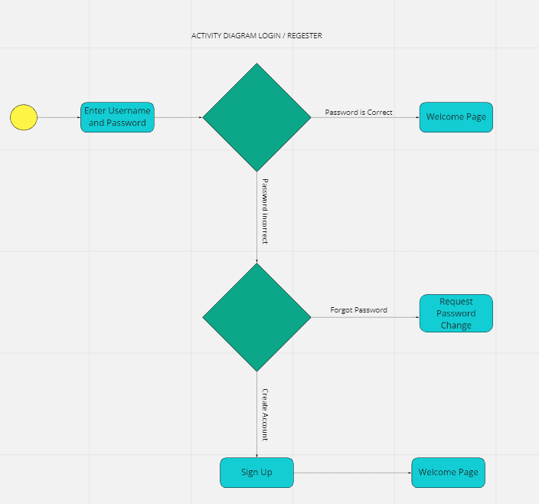

Slide 15
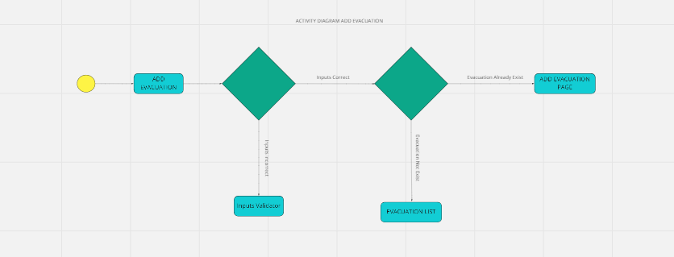

Slide 16
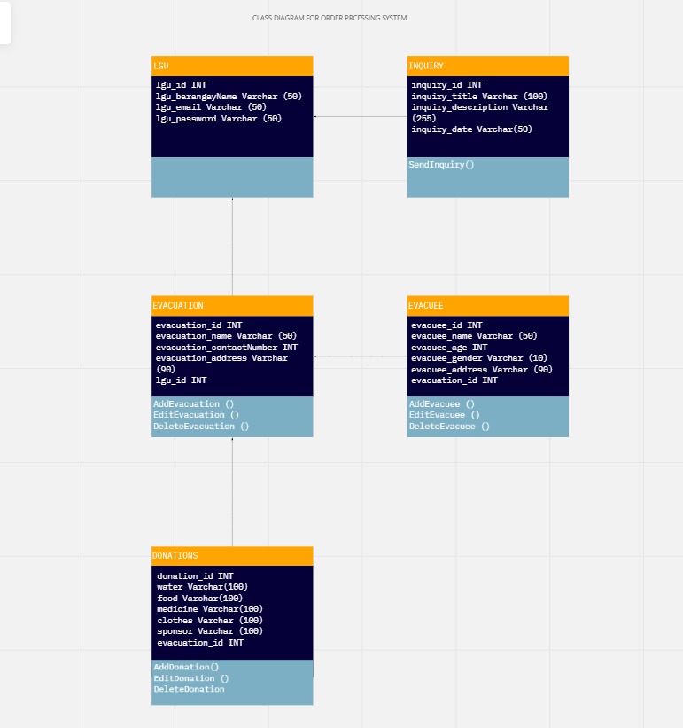

Slide 17
Thanks!

